Slide 1
DYNAMIC WEATHER DASHBOARD
CAPSTONE PROJECT
Presented By:
1. Student Name- Madhusudan
2. College Name- Hindustan College of Arts & Science
3. Department- BCA (Computer Appications)

Slide 2
OUTLINE
Problem Statement
System Development Approach
Algorithm & Deployment
Result
Conclusion
Future Scope
References

Slide 3
Problem Statement
In a digital world saturated with information, users often face challenges in getting quick, clear, and relevant weather data. Many existing weather platforms are cluttered with advertisements, complex meteorological charts, or overwhelming data points that are not useful for the average person.
This project addresses the following problems:
Information Overload: Users need a simple, easy-to-understand interface that presents the most important weather information without distractions.
Lack of Context: Raw data like temperature is useful, but users also benefit from actionable advice based on the conditions (e.g., "Don't forget your umbrella!").
Static Experience: Many websites lack interactivity and modern features like theme switching or real-time local clocks, leading to a less engaging user experience.
Location Inconvenience: Users should be able to get weather for their current location instantly without manual searching.
There is a clear need for a lightweight, visually appealing, and interactive weather application that solves these issues by providing a clean interface, smart suggestions, and a seamless user experience on any device.

Slide 4
System Approach
Frontend Technologies:
HTML5: Used to build the semantic structure and foundation of the web application.
CSS3: Employed for all styling, including the responsive layouts, the "glassmorphism" design, and the cloud-themed light and dark modes. No external frameworks were used.
JavaScript (ES6+): The core engine of the application. It handles all dynamic functionality, including API calls, DOM manipulation, and user events.

Slide 5
APIs Used:
OpenWeatherMap API: A third-party service used to fetch real-time weather data, 5-day forecasts, and timezone information.
Browser Geolocation API: A built-in browser API used to securely request and retrieve the user's current geographical coordinates.
Design Approach:
User-Centric Design: The interface is designed to be clean, modern, and intuitive.
Mobile-First Responsiveness: The layout was built to be fully functional on all screen sizes.
Modular Code: The project is organized into separate HTML, CSS, and JavaScript files.

Slide 6
Algorithm & Deployment
The application follows a logical, event-driven procedure:
Initialization: On page load, the app sets up event listeners, checks for a saved theme, and displays a welcome message.
Data Fetching (User-Triggered):
Geolocation: If the "Use My Location" button is clicked, the app uses the Geolocation API to get coordinates.
City Search: If the user types a city and presses "Enter," the app fetches data for that city.
An asynchronous fetch request is sent to the OpenWeatherMap API.
UI Rendering & Display:
On a successful API response, the received JSON data is used to populate the main weather panel, the 5-day forecast, and the weather suggestions.
A live-updating clock is started using the timezone offset from the API.

Slide 7
Error Handling: The app displays user-friendly error messages for failed API requests (e.g., city not found) or if the user denies location permission.
Deployment: The project consists of static files and can be easily deployed for free on hosting platforms like GitHub Pages or Netlify.

Slide 8
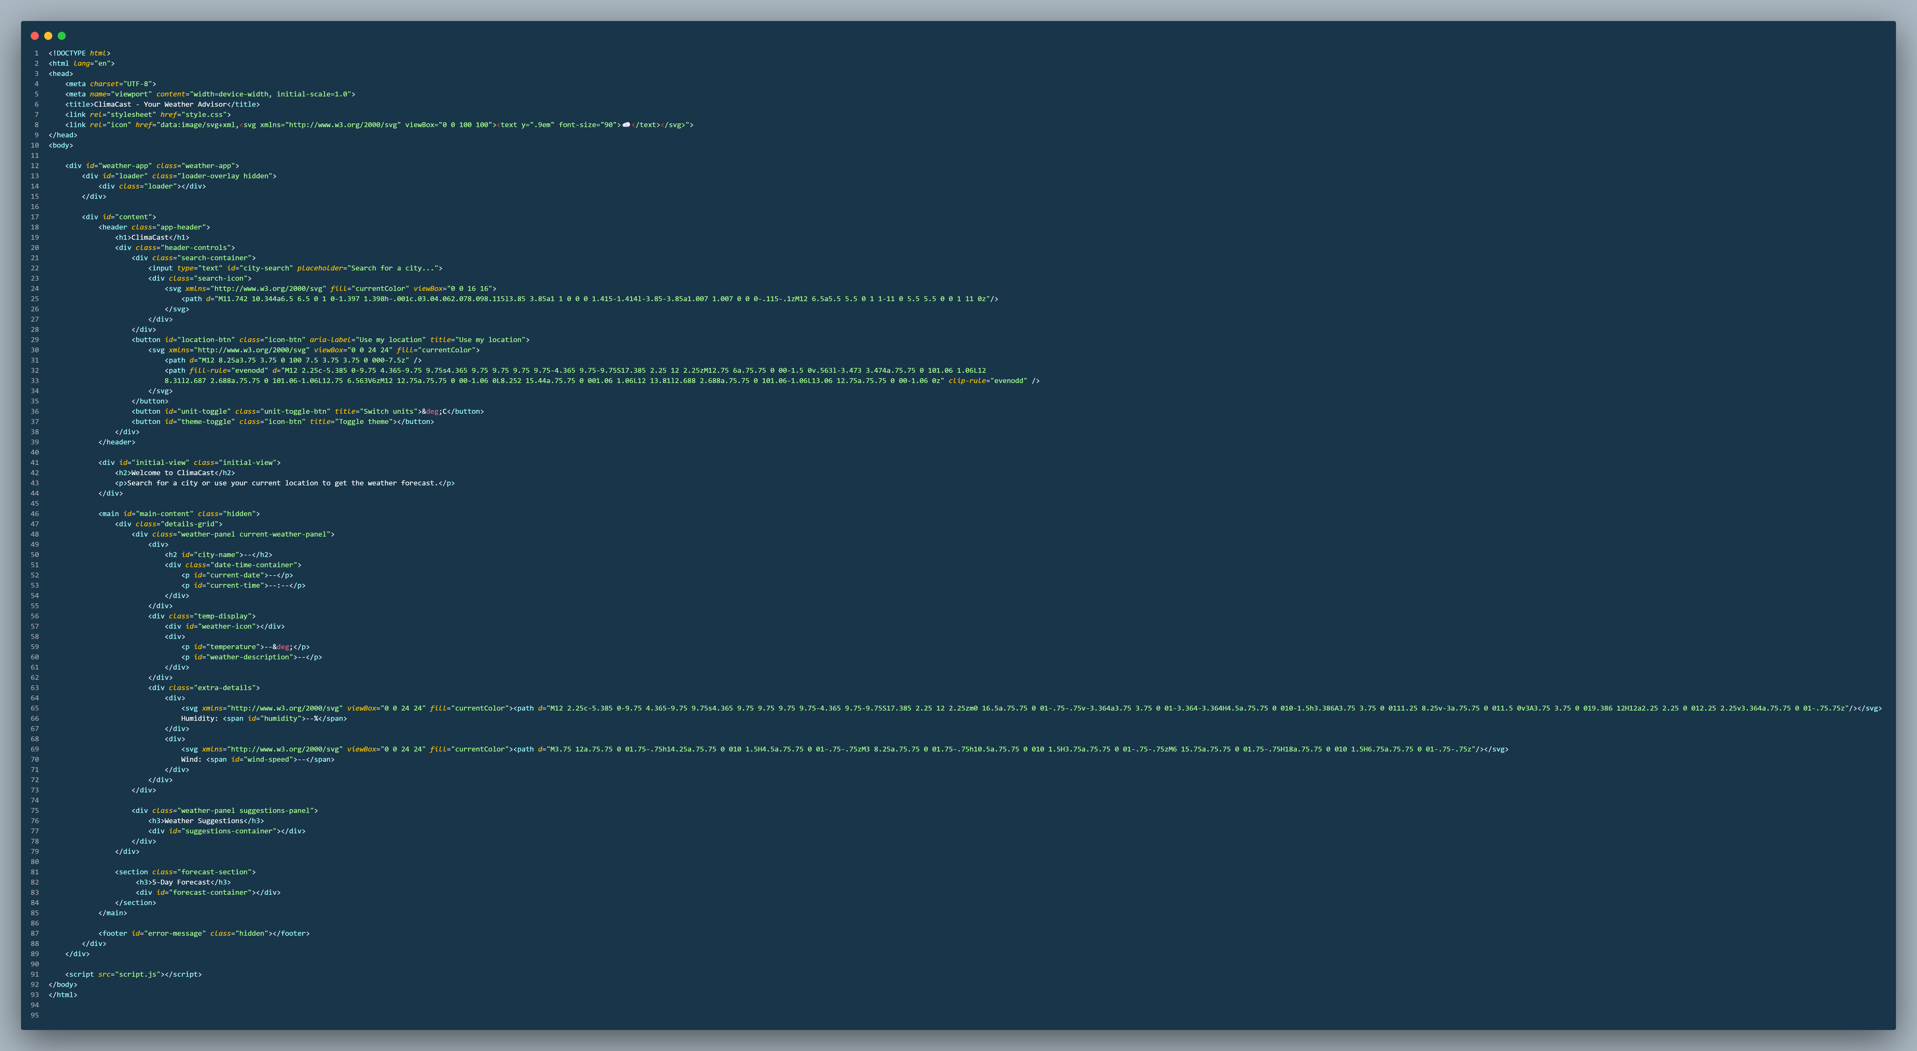
Result
Html Code
-- >

Slide 9
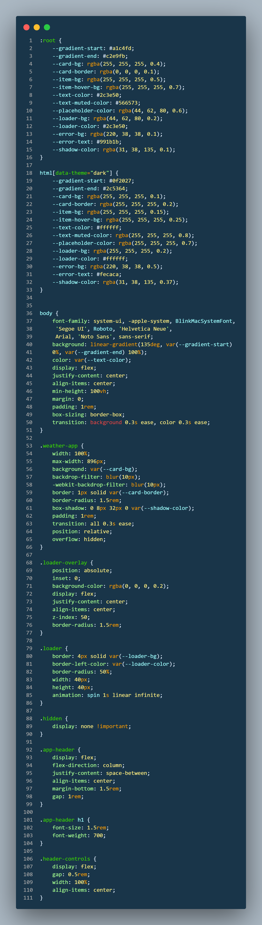
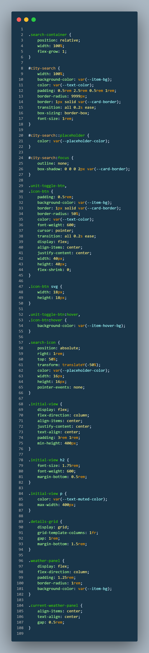
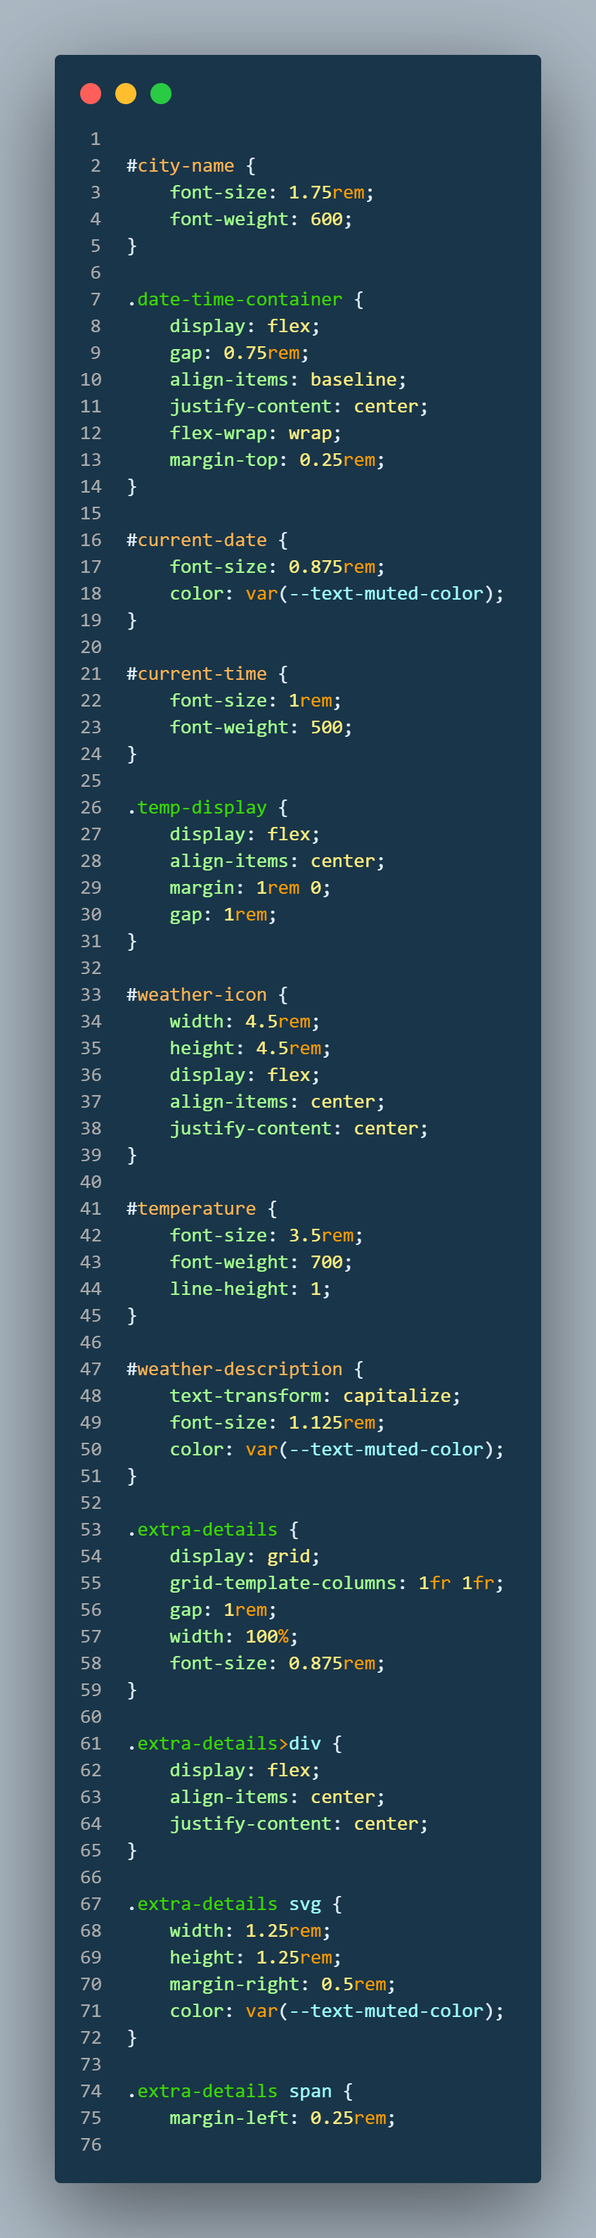
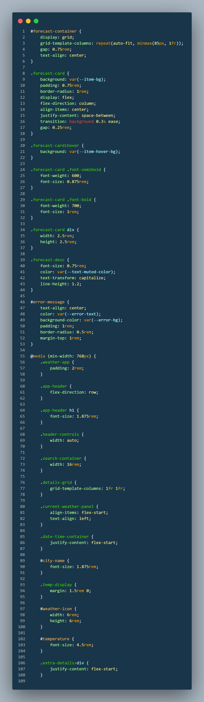
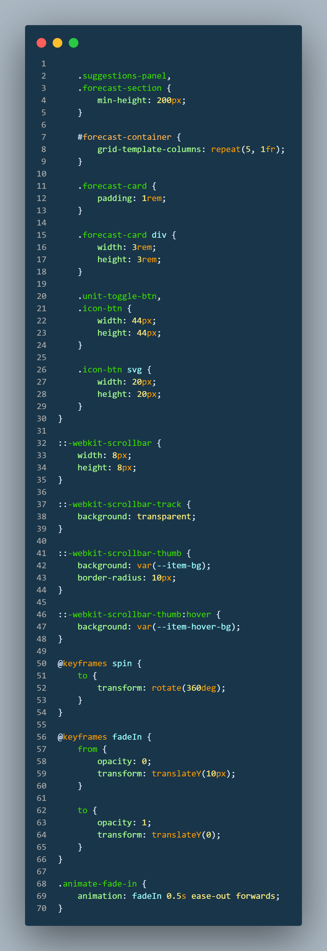
Result
CSS Codes
-->

Slide 10
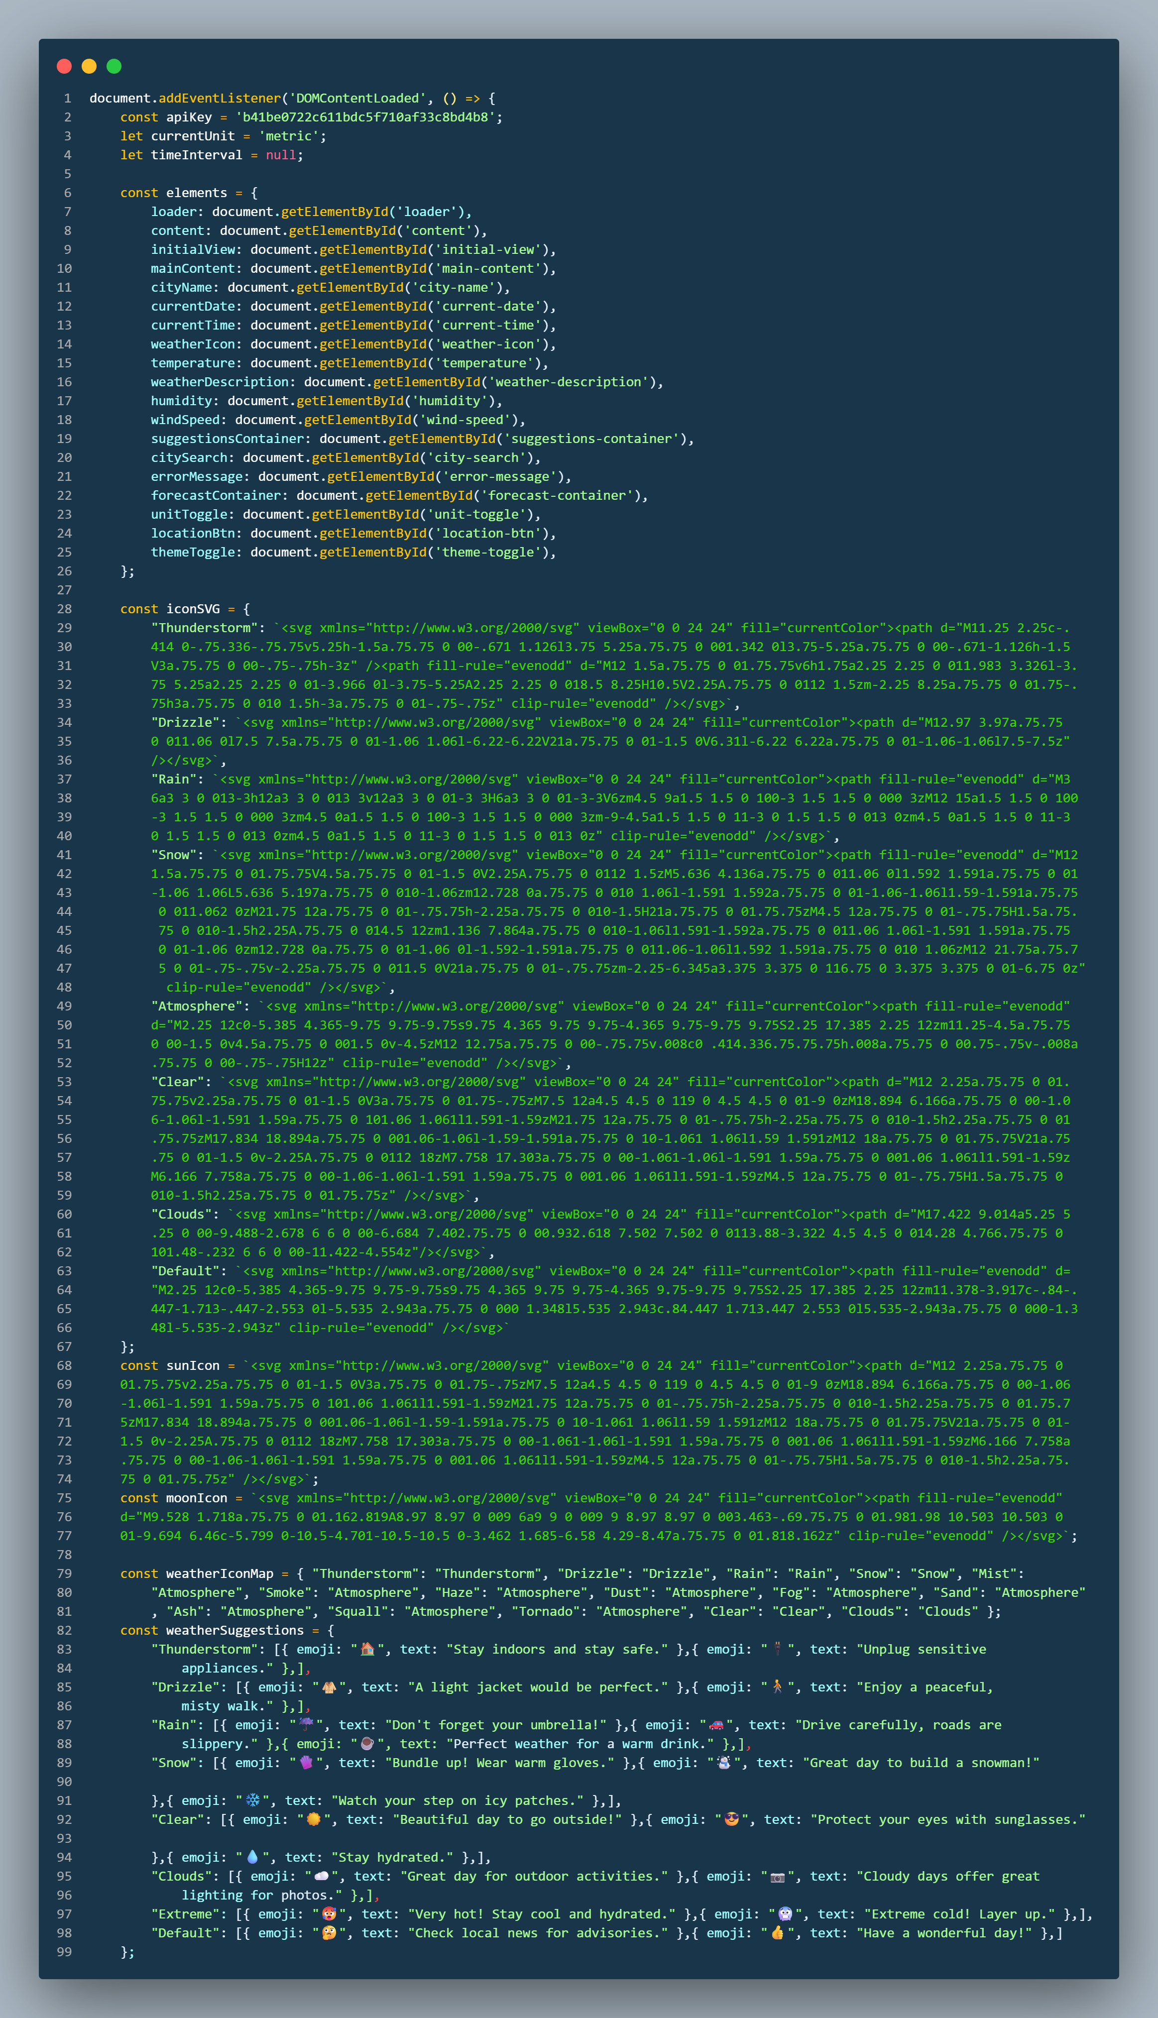
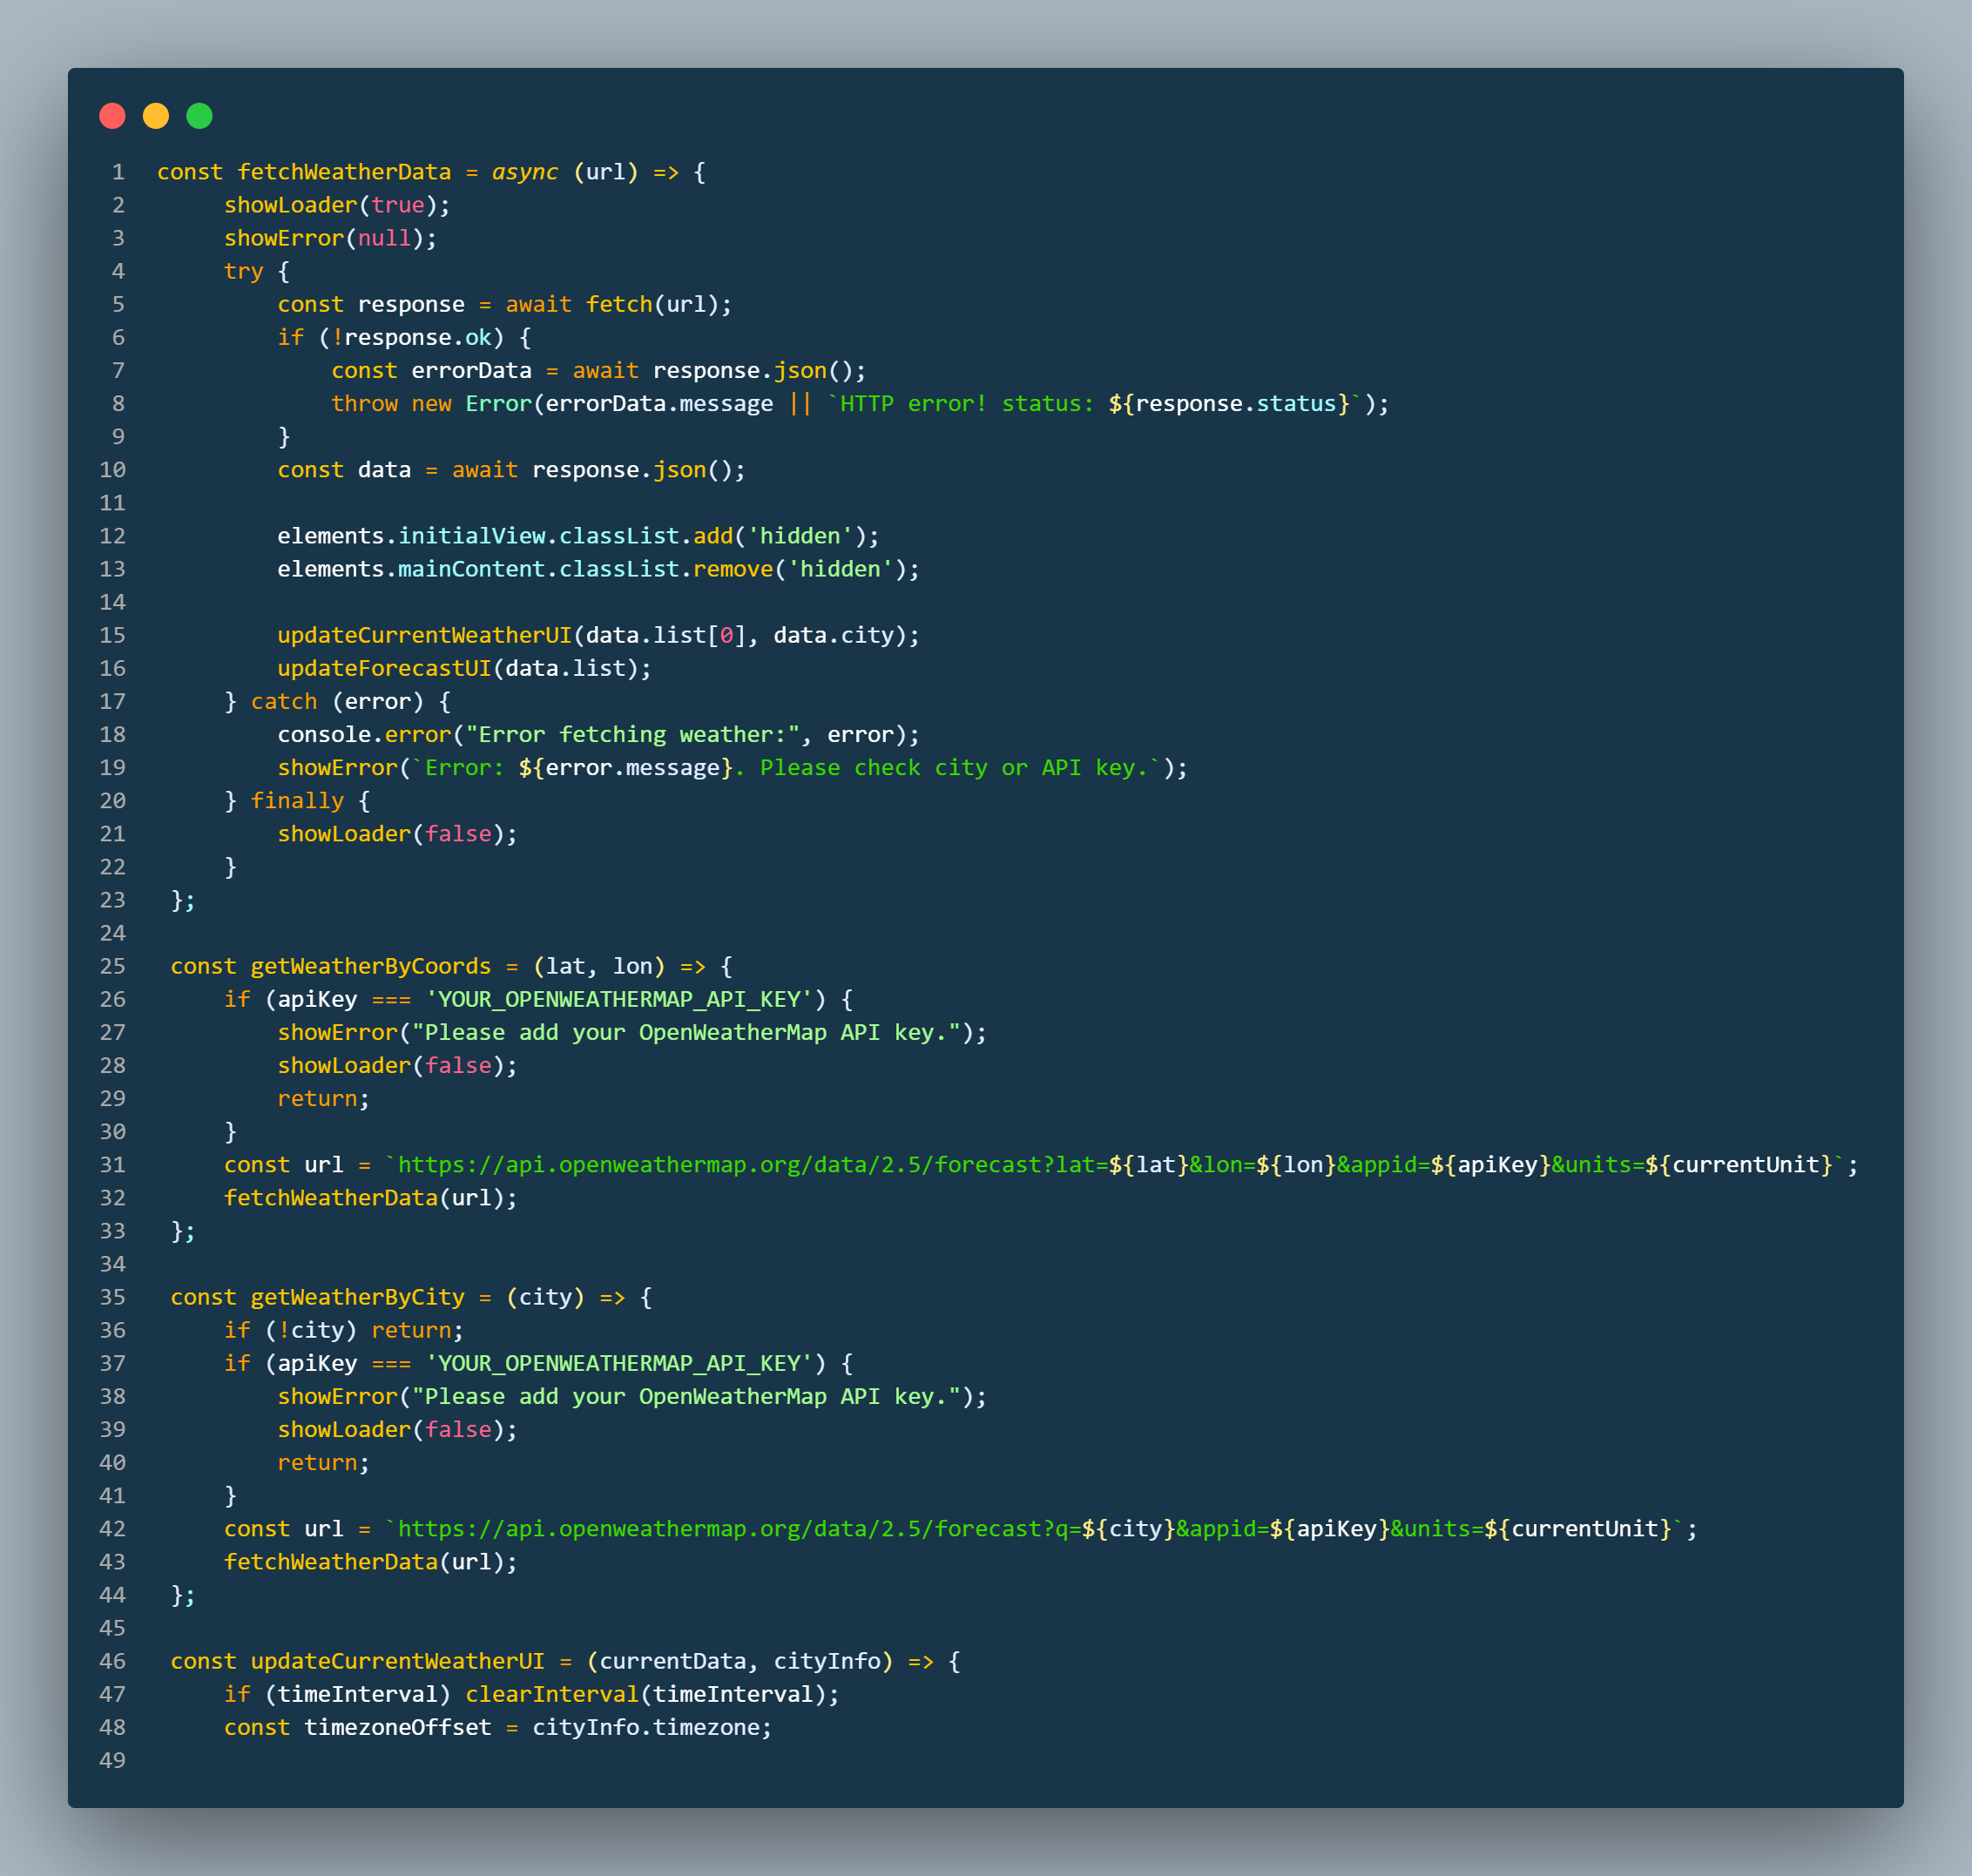
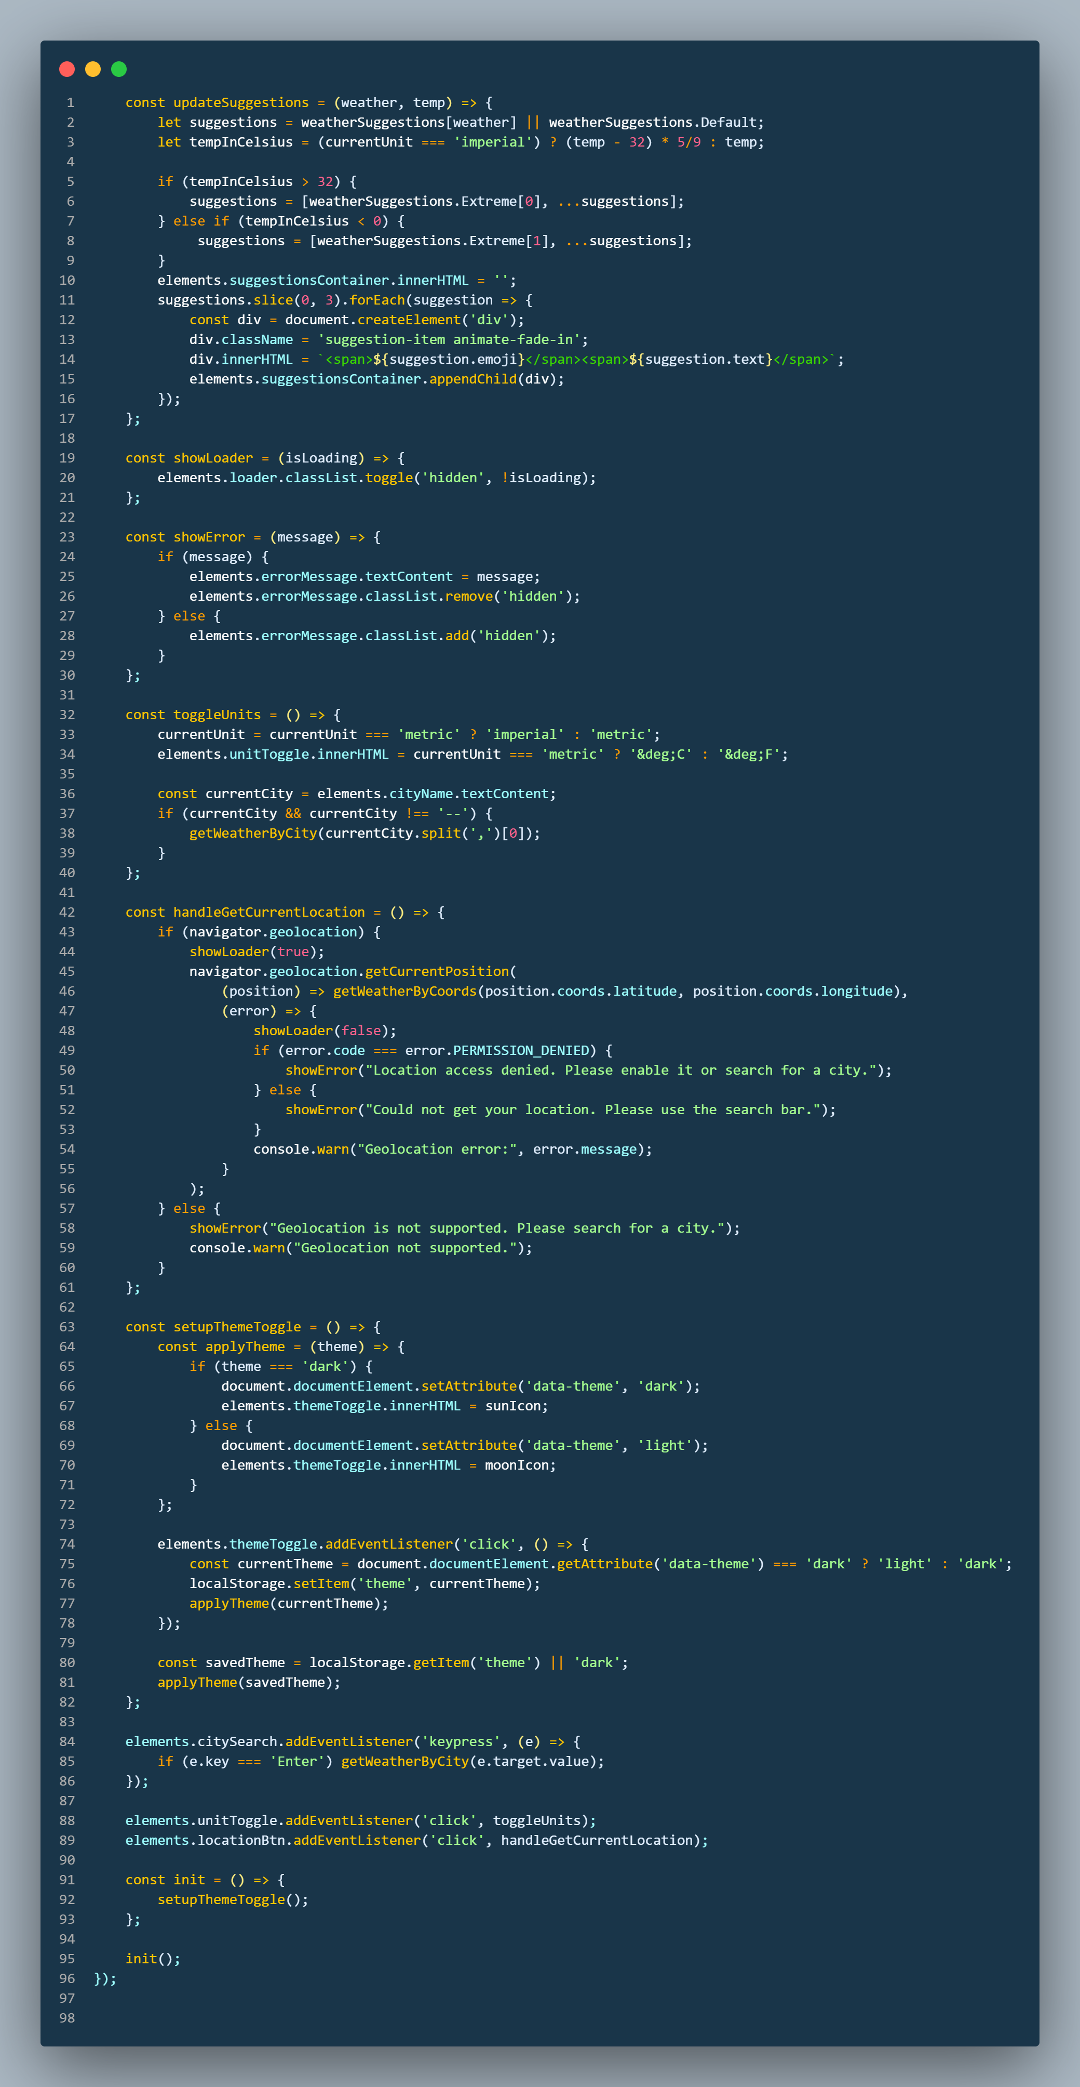
Result
JavaScript Codes

Slide 11
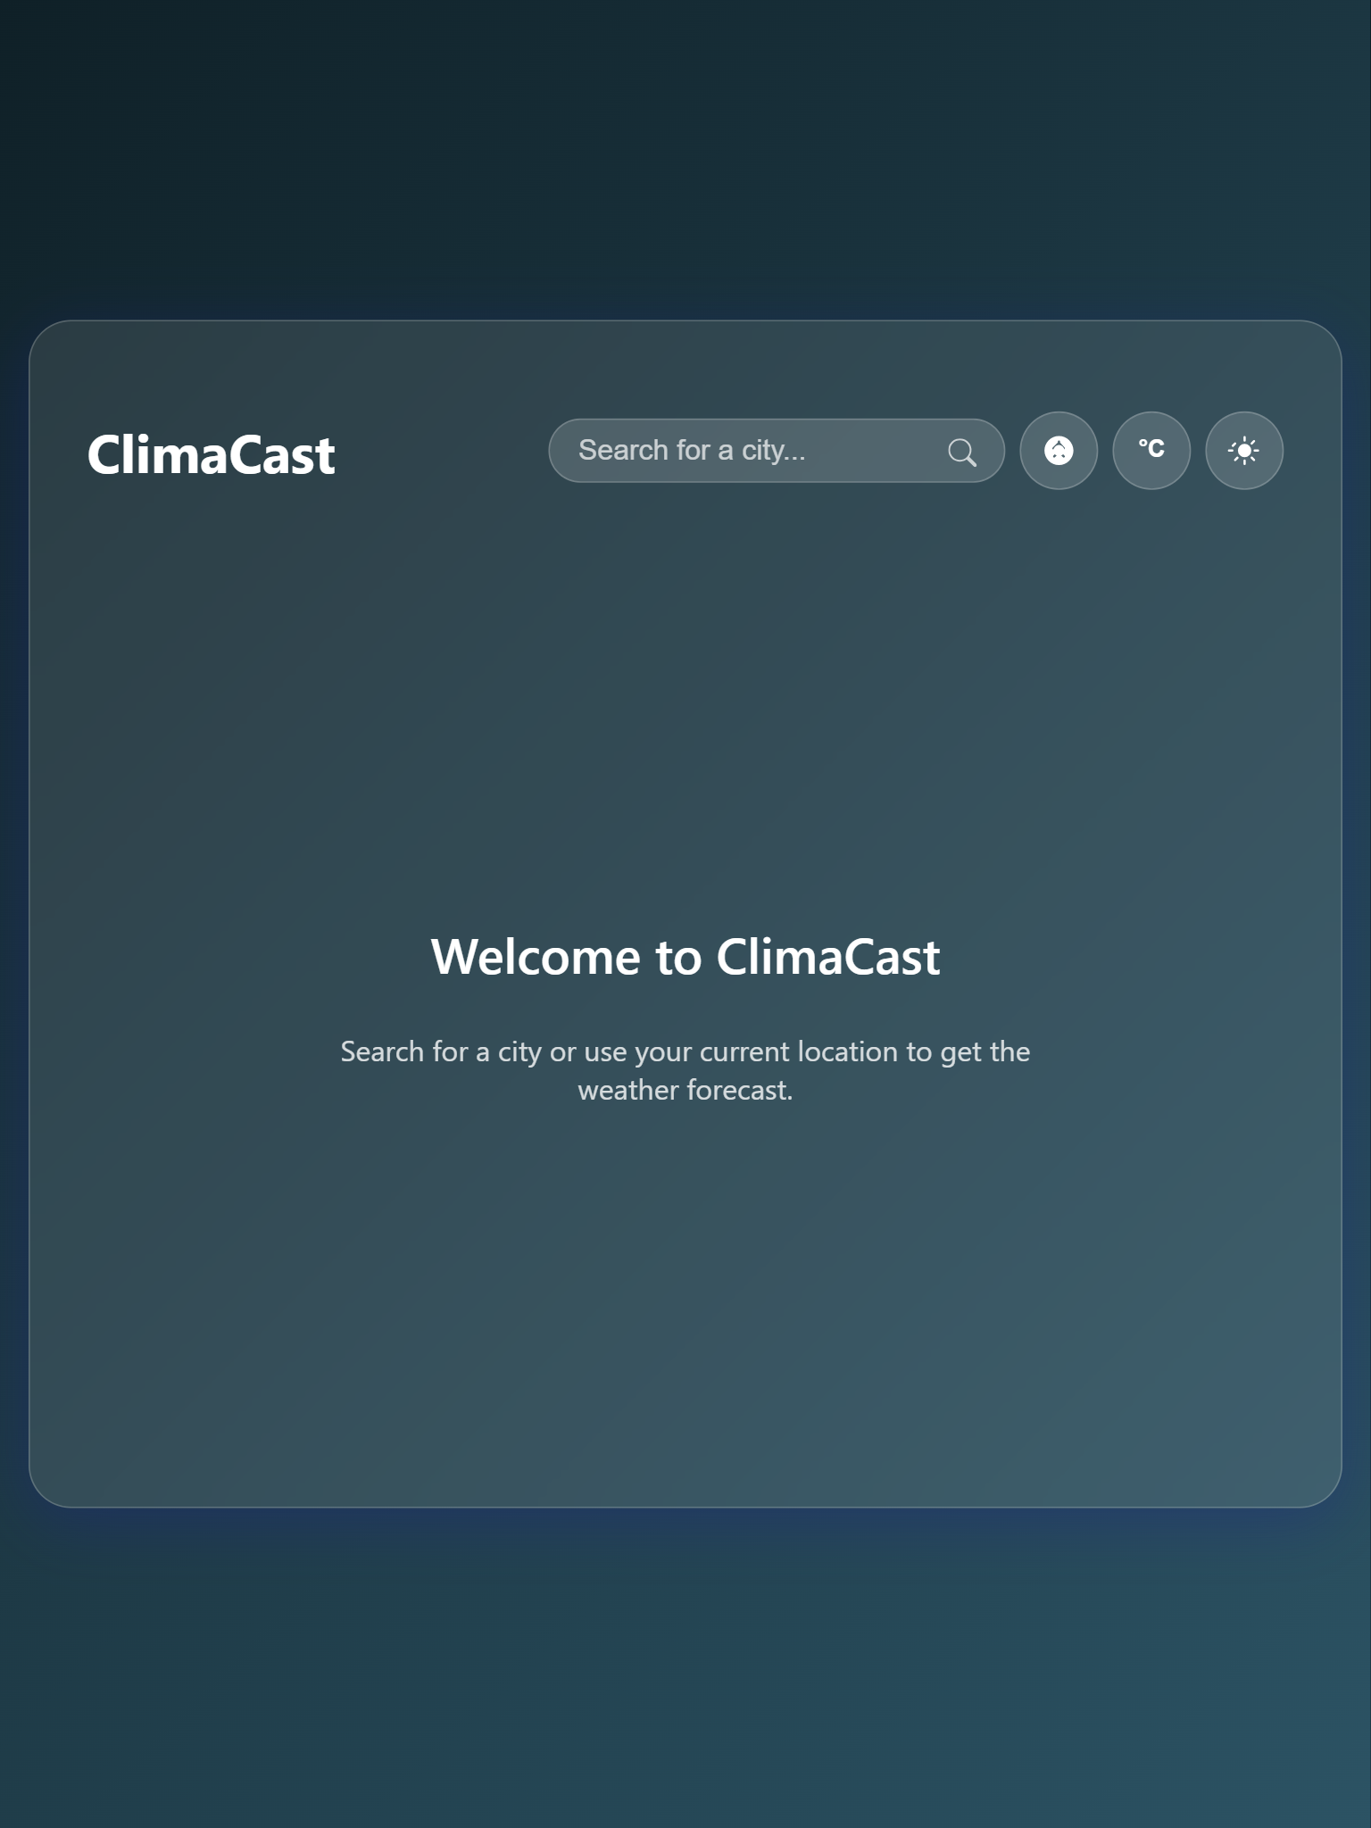
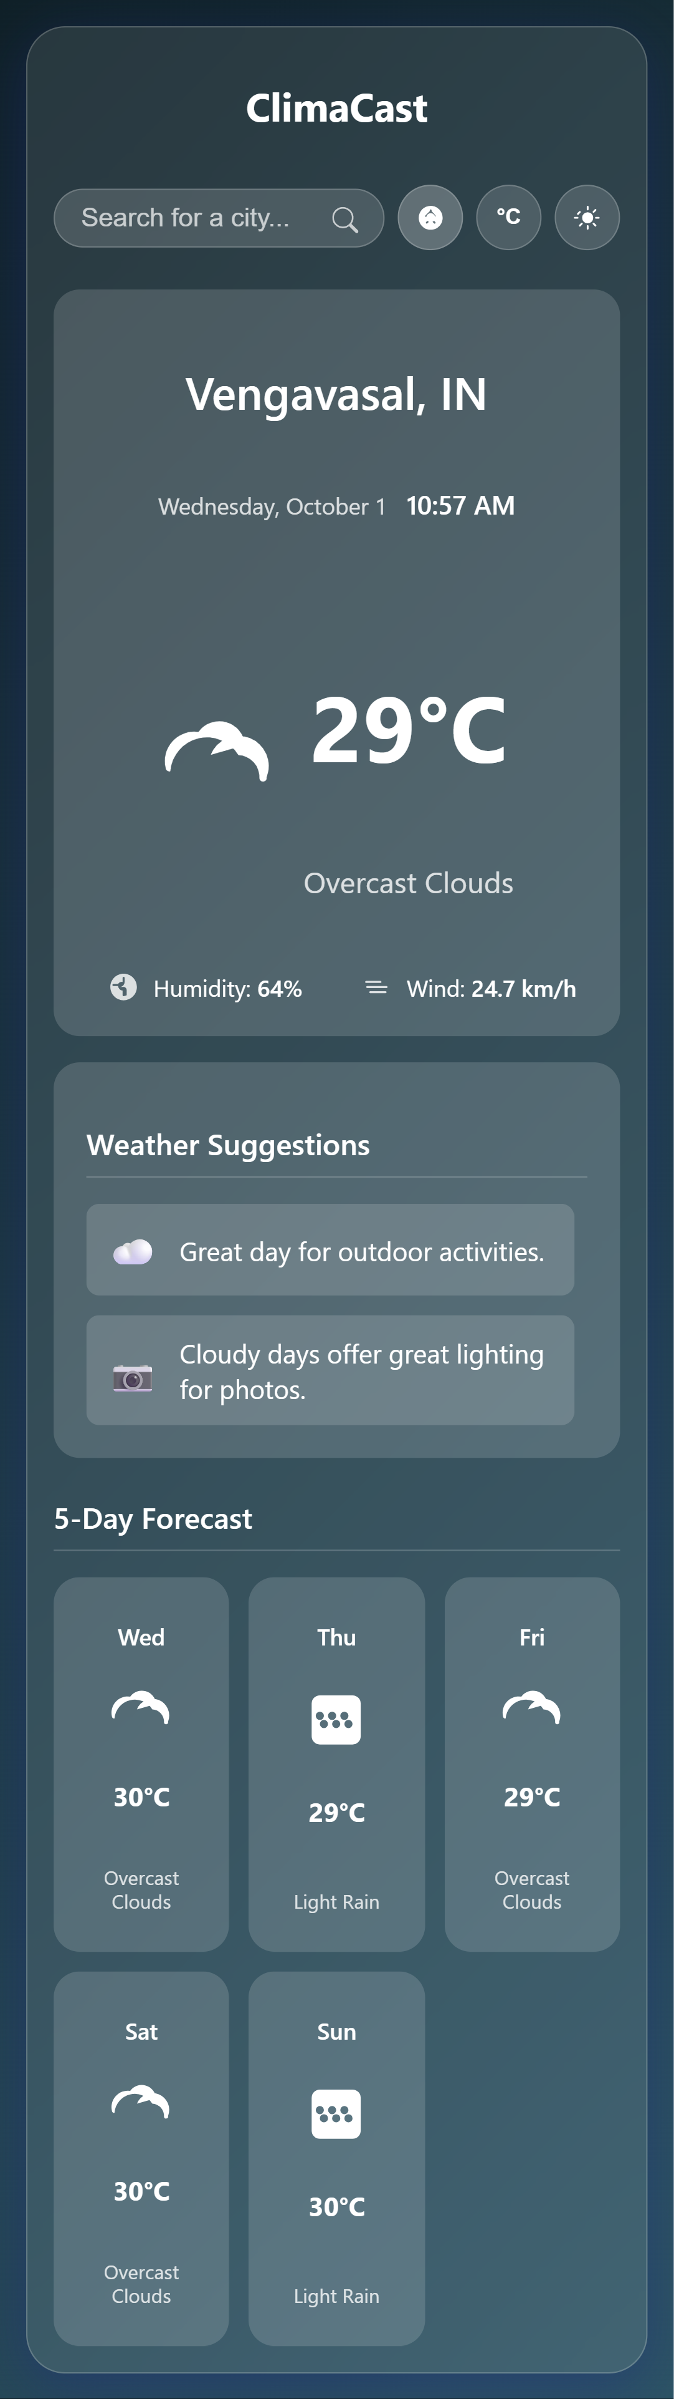
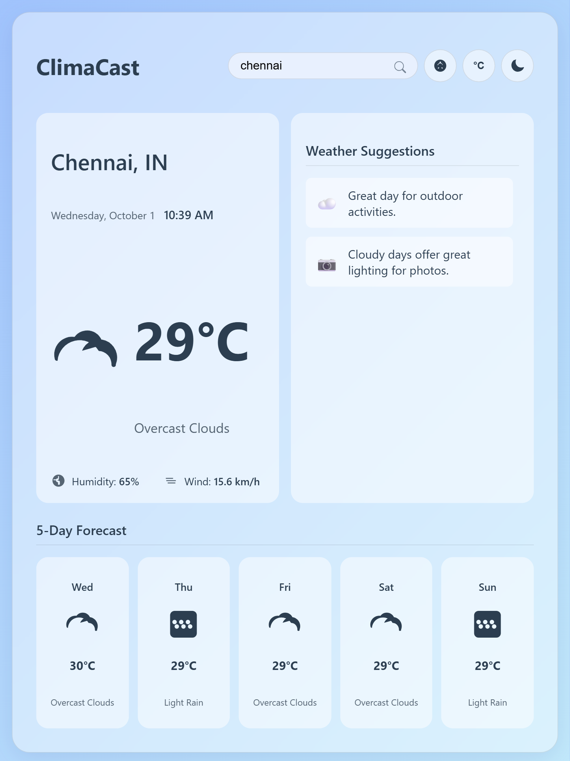
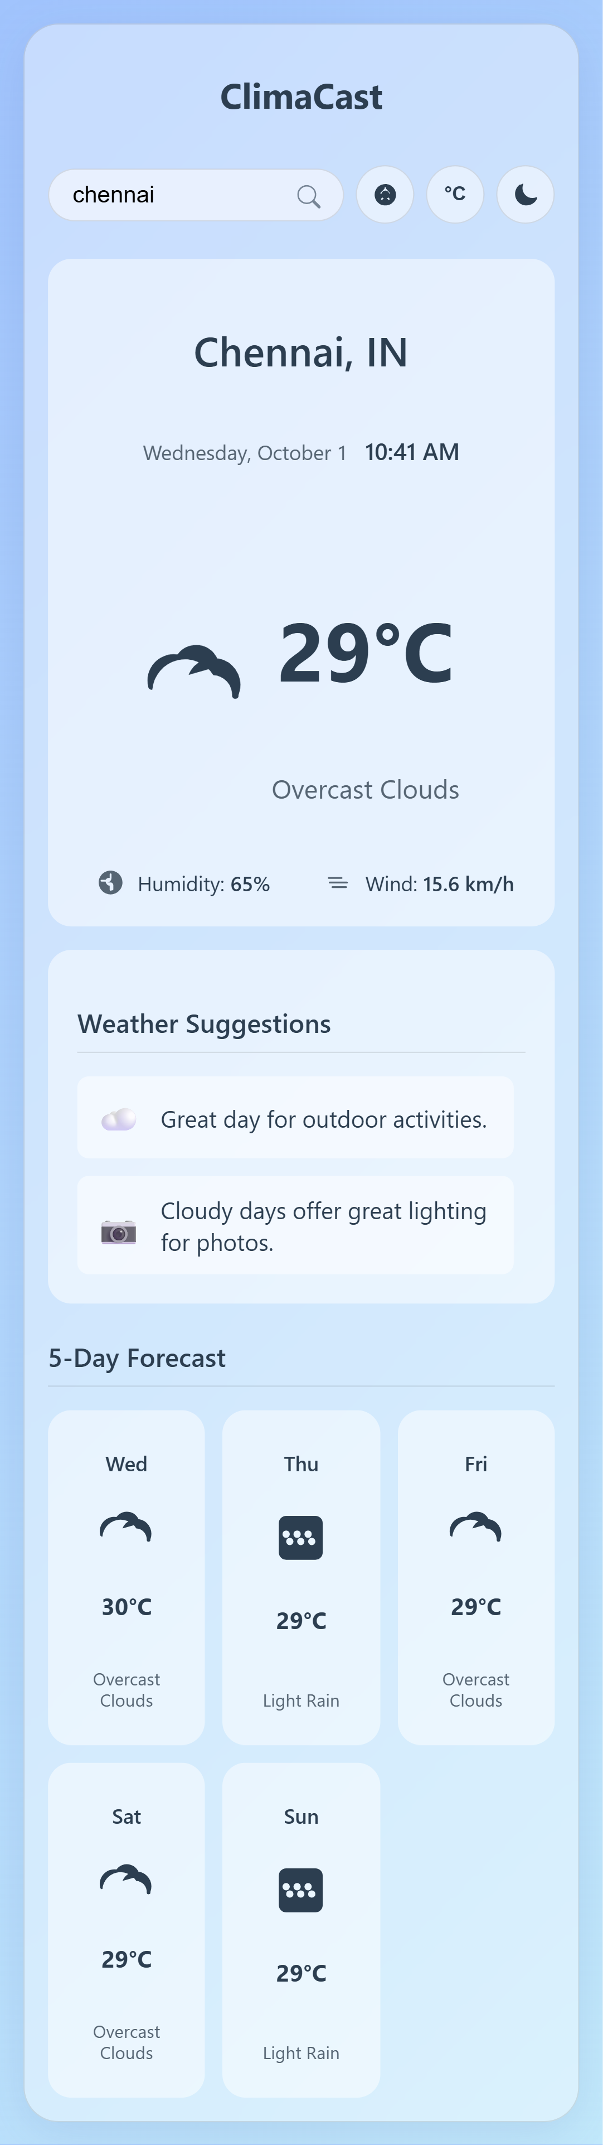
Result

Slide 12
Result
Repository Link:- https://github.com/Madhusudan04337/climacast-weather-app.git
Deployment Link:- https://madhusudan04337.github.io/climacast-weather-app/

Slide 13
Conclusion
ClimaCast successfully provides a cost-effective, user-friendly, and visually appealing solution for accessing essential weather information. By leveraging modern web technologies and third-party APIs, it eliminates the dependency on cluttered, ad-heavy weather platforms. The project demonstrates proficiency in HTML5, CSS3, and modern JavaScript, including asynchronous programming and DOM manipulation. The final product is an engaging and interactive customer experience that is both functional and beautiful.

Slide 14
Future scope
While the current version is a complete product, there are several features that could be added to further enhance it:
Detailed Weather View: Add more data points like UV index, sunrise/sunset times, and hourly forecasts.
Saved Locations: Allow users to save a list of favorite cities for quick access.
Weather Alerts: Integrate a system to display notifications for severe weather alerts.
Map Integration: Add a map view to visualize weather patterns across different regions.

Slide 15
References
OpenWeatherMap API Documentation:
https://openweathermap.org/api
MDN Web Docs (Mozilla Developer Network): For documentation on HTML, CSS, and the Geolocation API.
https://developer.mozilla.org
SVG Icons: Icons were self-contained and implemented directly in the project files.

Slide 16
THANK YOU

